Slide 2
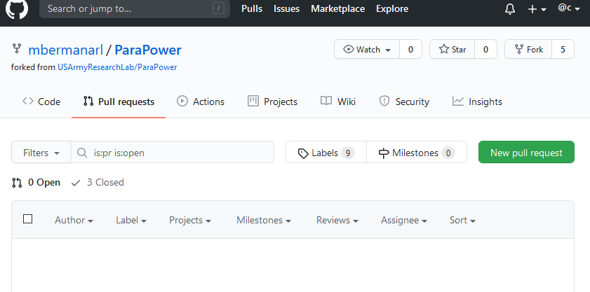
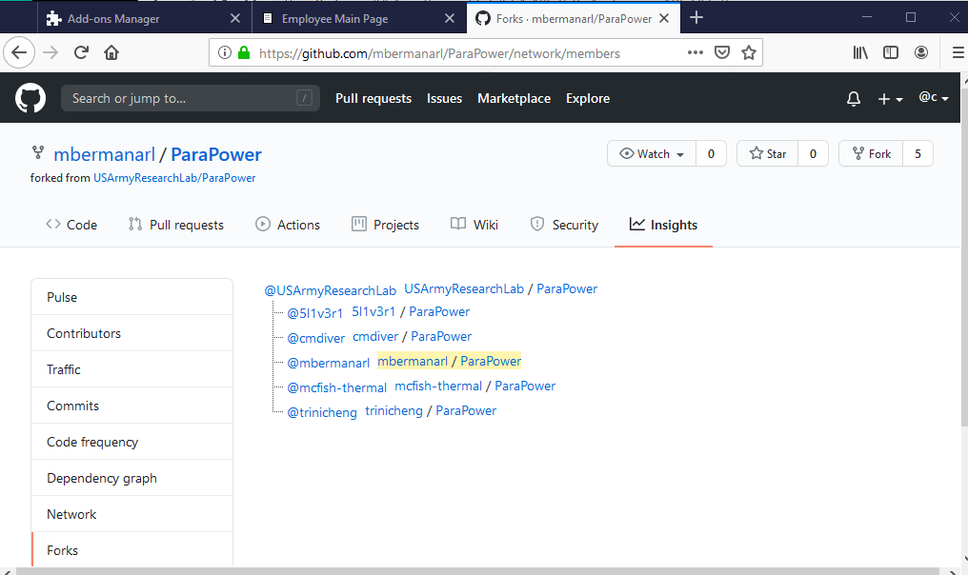
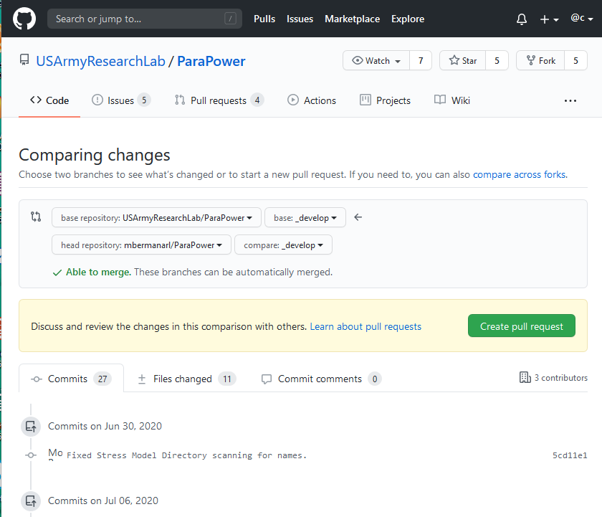
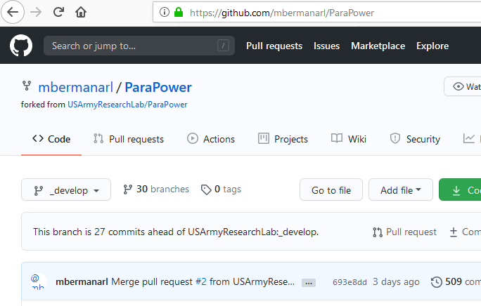
Generating a Pull Request on GITHUB
5. Click on “New Pull Request”
1. Get List of Forks (Click on number)
2. Click on Fork with branch to merge
6. Confirm destination repo.
7. Confirm destination branch
12. Create Pull Request
3. Confirm you’re in the right repo.
8. Confirm source repo.
9. Confirm source branch
10. GITHUB will confirm mergability
11. Review list of changes (here and below)
4. Click on “Pull Requests”

